Slide 1
Book Recommendations
Brian Bell

Slide 2
Finding new books
Collaborative Filtering
Clustering
Natural Language Processing

Slide 3
Book Crossing Dataset
Books: Title, Author, ISBN, Year, Publisher
Users: userID, age, location
Ratings: userID, ISBN, Rating
http://www2.informatik.uni-freiburg.de/~cziegler/BX/

Slide 4
Data Wrangling
ISBNs in Ratings data were a mess
  Left off leading/trailing zeros
  Extra junk characters (#-<>*)
  Included 'ISBN:'
Dropped 0 ratings

Slide 5
Data Wrangling (cont)
Many entries in Ratings not in Books
Tried to match with pd.str.contains()
Pulled book info from goodreads API
Saved “Description” for each book from GR

Slide 6
Data Exploration
Data was very sparse
  Most People have not read most books
  Many users only had one rating
  Many books were unrated

Slide 7
Data Exploration
Books in many languages (mostly English)
Average rating of 7.6

Slide 8
Collaborative Filtering
For a given book, find users that read it
Build DF of all ratings from those users
Pivot Table of userID x ISBN
For each column:

Slide 9
Collaborative Filtering
For a given user, find all rated books
Find all users that have rated those books
Build DF of all ratings by those users
Pivot Table of userID x ISBN
For each user:
For each ISBN:

Slide 10
Collaborative Filtering
Results were great...when there were any
Many books unrated
Many users with only one book rated
Results restricted to one degree of sep.

Slide 11
Clustering
TruncatedSVD on pivot table
  Reduce dimensionality
  Lets it fit in memory
Kmeans on component vectors
  Many users bunched at origin

Slide 12
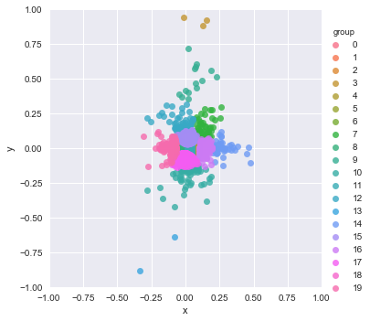
Clustering Results
Majority of users in one cluster
Many Clusters of 1

Slide 13
Language Processing
Tries to address the cold-start problem
Built bigrams and trigrams
Latent Dirichlet Allocation to form topics
Cosine similarity between LDA descriptions to find similar books

Slide 14
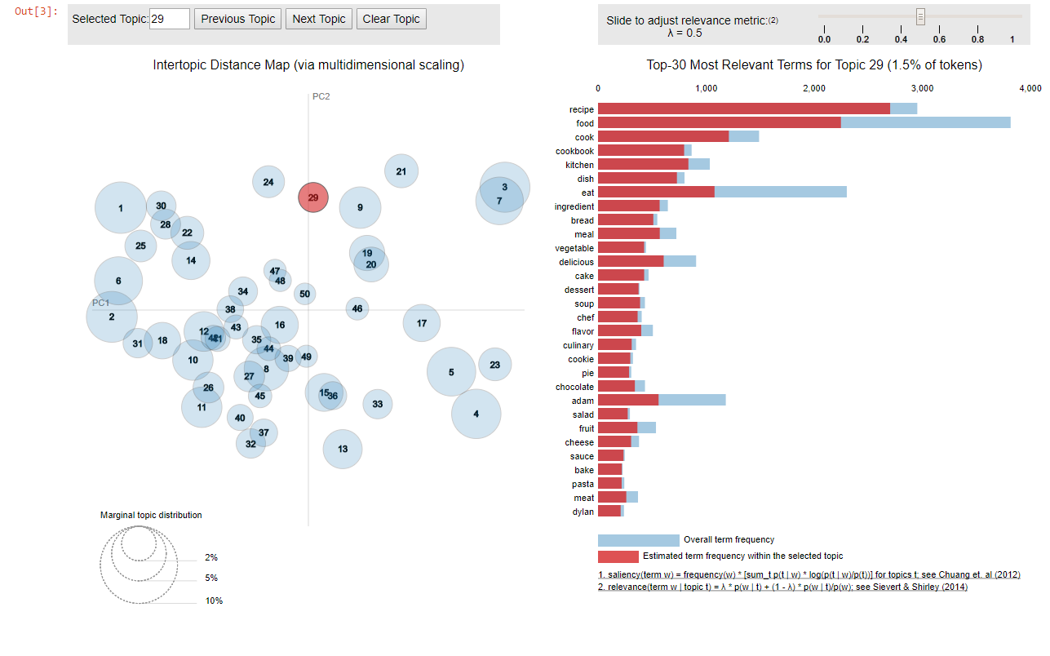
LDA Map

Slide 15
Word Vectors
Made 100 dimensional vectors for vocab
Added word vectors to make description vectors.
Compared description vectors with cosine similarity
Allowed for description text from outside the dataset

Slide 16
'pirate adventure romance'
Treasure Island|Robert Louis Stevenson|0.777
My Lady Pirate|Elizabeth Doyle|0.775
Captain Abdul's Pirate School|Colin McNaughton|0.774
The Mountain of Adventure and The Ship of Adventure: Two Great Adventures|Enid Blyton|0.762
Oceans of Magic|Brian M. Thomsen|0.761
Oceans of Space|Brian Thomsen|0.756
To Gather the Wind: The Wayward Wind Series|Bodie Thoene|0.755
Osten's Bay|Zenobia N. Vole|0.754
Cup of Gold|John Steinbeck|0.746

Slide 17
Client Use
Collaborative Filtering/Clustering favors frequently rated books
LDA and Word Vectors do not
The best user experience would combine the two lists

Slide 18
Improvements
Bring in extra language support
Use manifold learning instead of truncatedSVD

